Slide 1
CEN 3078 Computer Security
Module 2 – Application and Network Attacks

Slide 2
TCP fundamental
Attacks on the TCP protocol
Denial-of-Service attack
SQL injection attack
Cross-side scripting attack
Miscellaneous: Heartbleed bug and attack, Ransomware, Cryptojacking
Module 2

Slide 3
TCP fundamental
Attacks on the TCP protocol
Denial-of-Service attack
SQL injection attack
Cross-side scripting attack
Miscellaneous: Heartbleed bug and attack, Ransomware, Cryptojacking
Module 2

Slide 4
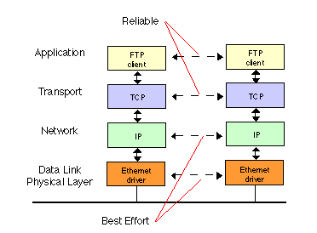
TCP Protocol
Transmission Control Protocol (TCP) is a core protocol of the Internet protocol suite
Sits on the top of the IP layer; transport layer
Provide host-to-host communication services for applications
Two transport Layer protocols
TCP: provides a reliable and ordered communication channel between applications
UDP: lightweight protocol with lower overhead and can be used for applications that do not require reliability or communication order
4

Slide 5
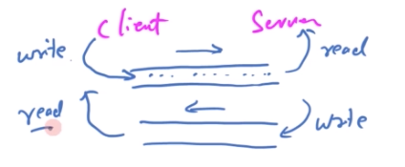
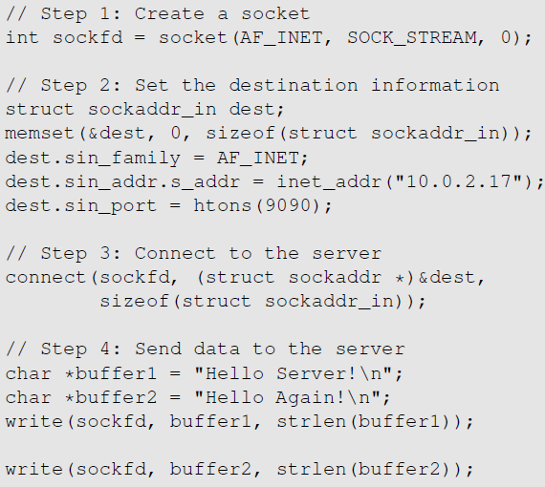
TCP Client Program
Create a socket; specify the type of communication. TCP uses SOCK_STREAM and UDP uses SOCK_DGRAM.
Initiate the TCP connection
Send data
5

Slide 6
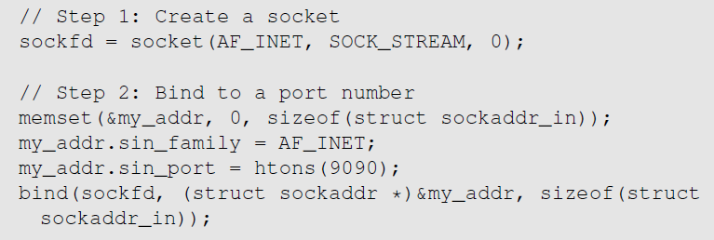
TCP Server Program
Step 1 : Create a socket. Same as Client Program.
Step 2 : Bind to a port number. An application that communicates with others over the network needs to register a port number on its host computer. When the packet arrives, the operating system knows which application is the receiver based on the port number. The server needs to tell the OS which port it is using. This is done via the bind() system call
6
Notes:
Client programs also need to register a port number. They can use bind() , but it is not necessary as the clients need to reach out to others to know what port the servers are using. Clients can leave the decision to the operating system. So, when they initiate a connection using connect(), operating systems will randomly assign a random port numbre to them.

Slide 7

TCP Server Program
Step 3 : Listen for connections.
After the socket is set up, TCP programs call listen() to wait for connections
It tells the system that it is ready to receive connection requests.
Once a connection request is received, the operating system will go through the 3-way handshake to establish the connection
The established connection is placed in the queue, waiting for the application to take it. The second argument gives the number of connection that can be stored in the queue
7

Slide 8
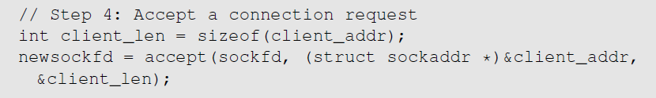
TCP Server Program
Step 4 : Accept a connection request
After the connection is established, an application needs to “accept” the connection before being able to access it. The accept() system call extracts the first connection request from the queue, creates a new socket, and returns the file descriptor referring to the socket
Step 5 : Send and Receive data
Once a connection is established and accepted, both sides can send and receive data using this new socket
8

Slide 9
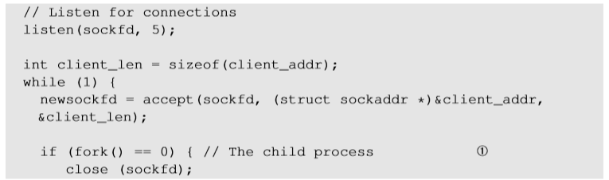
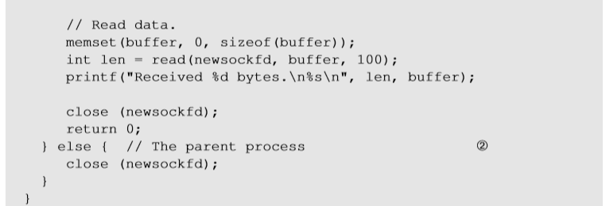
TCP Server Program
To accept multiple connections :
fork() system call creates a new process by duplicating the calling process
On success, the process ID of the child process is returned in the parent process and 0 in the child process
Line ① and Line ② executes child and parent process respectively
While loop is a connection queue – waits if there are no connections, and then if they arrive, they are processed one by one
9
Notes:
While loop is a connection queue – waits if no connections, and then if they arrive, they are processed one by one
Parent closes connection socket but delete from file descriptor table – then go back to while loop again

Slide 10
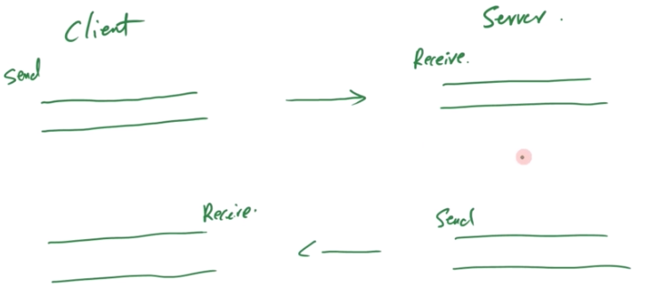
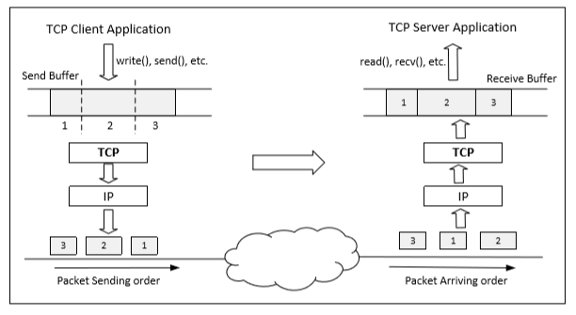
Data Transmission
Once a connection is established, OS allocates two buffers at each end, one for sending data (send buffer) and receiving buffer (receive buffer)
When an application needs to send data out, it places data into the TCP send buffer
Timing of ~200ms is used to fill the send buffer – max size of a packet you can send to Layer 2
10
Notes:
Timing 200ms to fill the send buffer – max size of a packet you can send to Layer 2

Slide 11
Data Transmission
Each octet in the send buffer has a sequence number field in the header which indicates the sequence of the packets
At the receiver end, these sequence numbers are used to place data in the right position inside receive buffer
Once data is placed in the receive buffer, they are merged into a single data stream
Applications read from the receive buffer - If no data is available, it typically gets blocked; It gets unblocked when there is enough data to read
The receiver informs the sender about receiving of data using acknowledgement packets
11
Notes:
Each packet in TCP will have different buffer on sender and sender; receiver identifies stream based on source port used by sender
Attack affects target connection, and so the elements need to be the same!

Slide 12
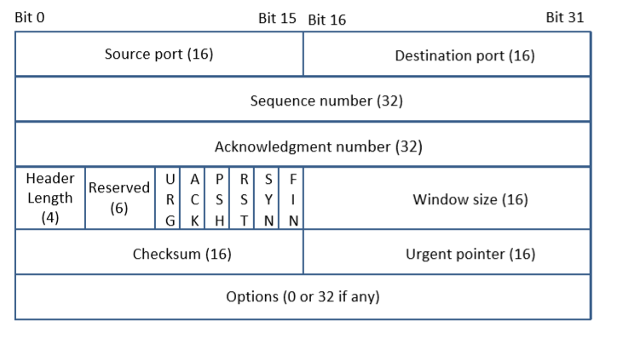
TCP Header
TCP Segment: TCP Header + Data.
Source and Destination port (16 bits each): Specify port numbers of the sender and the receiver.
Sequence number (32 bits) : Specifies the sequence number of the first octet in the TCP segment. If SYN bit is set, it is the initial sequence number.
Acknowledgement number (32 bits): Contains the value of the next sequence number expected by the sender of this segment. Valid only if ACK bit is set.
12
Notes:
TCP Sequence number # to maintain order of packets; flow/congestion control
Even if no data to send, I have to send ACK otherwise a resend will be required
TCP is bidirectional – sequence number will be different in both directions – acknowledgement is for received sequence number
6 standard bits; ACK – if turn ON/OFF it determines acknowledgement
If no options, header size is fixed
Urgent pointer – if data is urgent and do not want to put in end of header - turn ON urgent pointer that points to urgent data in packet

Slide 13
TCP Header
Header length (4 bits): Length of TCP header is measured by the number of 32-bit words in the header, so we multiply by 4 to get number of octets in the header.
Reserved (6 bits): This field is not used.
Code bits (6 bits): There are six code bits, including SYN,FIN,ACK,RST,PSH and URG.
Window (16 bits): Window advertisement to specify the number of octets that the sender of this TCP segment is willing to accept. The purpose of this field is for flow control.
Checksum (16 bits): The checksum is calculated using part of IP header, TCP header and TCP data.
Urgent Pointer (16 bits): If the URG code bit is set, the first part of the data contains urgent data (do not consume sequence numbers). The urgent pointer specifies where the urgent data ends and the normal TCP data starts. Urgent data is for priority purposes as they do not wait in line in the receive buffer, and will be delivered to the applications immediately.
Options (0-320 bits, divisible by 32): TCP segments can carry a variable length of options which provide a way to deal with the limitations of the original header.
13
Notes:
Flow Control : If one end of the connection sends data too fast, it may overwhelm the receive buffer of the other end and cause data being dropped.
By putting a smaller window value, the receiver can tell the sender to slow down.

Slide 14
Maintaining Order & Reliability
At the heart of TCP is the sliding window algorithm, but it needs to address:
Connections from many different hosts with - different RTT, different capacity at destination, long delays in network that affects order, different network capacity (i.e., congestion)
Flow control: keep sender from overrunning receiver
Congestion control: keep sender from overrunning network
Application process
Application process
Write
Read
bytes
bytes
TCP
TCP
Send buffer
Receive buffer
Segment
Segment
■ ■ ■
Segment
Transmit segments
14

Slide 15
Flow and Congestion Control
Based on flow condition, Window size is changed
Sender capacity (buffer limitation) or Network congestion (packet drop)
Sliding window + flow control
SequenceNum, Acknowledgment, AdvertisedWindow
SequenceNum: sequence # of the first byte
Receiver sends AdvertisedWindow based on available capacity
Window size is less than or equal to the minimum of AdvertisedWindow and CongestionWindow
15
Notes:
Based on flow condition window size is changed – sender capacity (buffer limitation) or network congestion (packet drop)
Flow control – how fast you can send
- Sender sends window advertisement – only 100 bytes left in buffer
- Receiver sends advertisement window size based on available capacity – and sender adjusts the window size to be less than the receiver window size advertisement
Window size chosen is min (congestion window and advertisement window)
Congestion control
Congestion window based on traffic situation

Slide 16
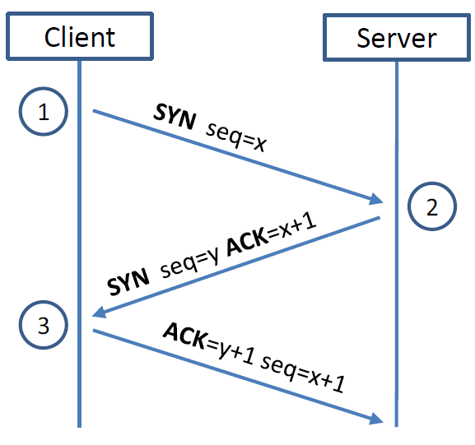
TCP 3-way Handshake Protocol
SYN Packet:
The client sends a special packet called SYN packet to the server using a randomly generated number x as its sequence number
SYN-ACK Packet:
On receiving it, the server sends a reply packet using its own randomly generated number y as its sequence number
ACK Packet
Client sends out ACK packet to conclude the handshake
Kernel establishes send and receive buffer on both sides
16
Notes:
Kernel establishes send and receive buffer on both sides

Slide 17
TCP 3-way Handshake Protocol
When the server receives the initial SYN packet, it uses TCB (Transmission Control Block) to store the information about the connection
This is called half-open connection as only client-server connection is confirmed
The server stores the TCB in a queue that is only for the half-open connection
After the server gets ACK packet, it will take this TCB out of the queue and store in a different place
If ACK doesn’t arrive, the server will resend SYN+ACK packet; The TCB will eventually be discarded after a certain time period
17
Notes:
The queue is not large, there is a limit – that creates issues
DoS attack – brute force attack won’t work for powerful server – they find Achilles heel to attack i.e., exhaust the queue with many SYN flooding packets so that there is no space for half-open connection

